Slide 1
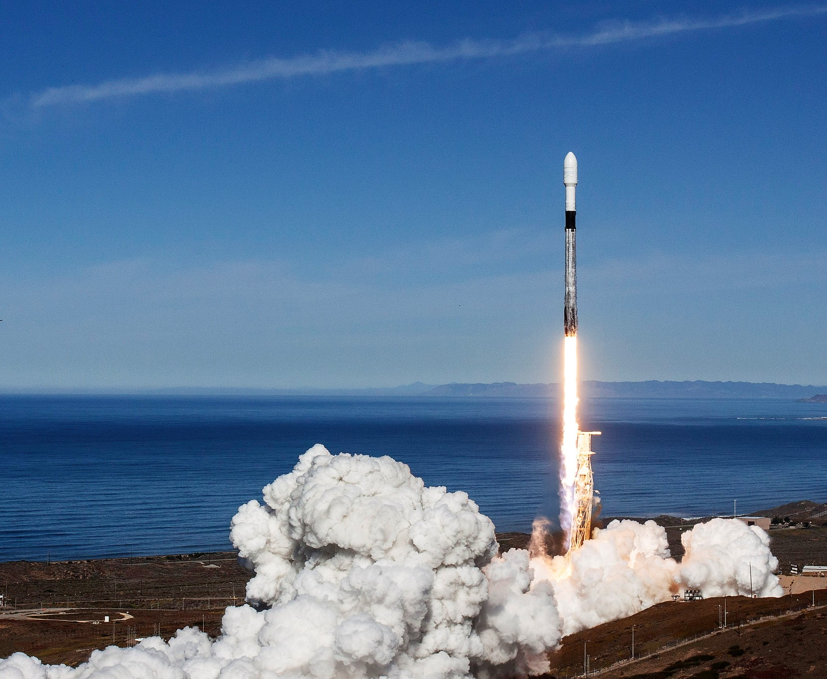

SpaceX Falcon 9 Landing Prediction
Tariq Elsheikh
April 11th, 2023

Slide 2
Outline
Executive Summary
Introduction
Methodology
Results
Conclusion
Appendix

Slide 3
Executive Summary
Summary of methodologies:
Data collection of SpaceX Falcon 9 using Spacex API.
Web scraping of SpaceX Falcon 9 records with BeautifulSoup.
Data wrangling of SpaceX Falcon 9.
Explore and prepare data of SpaceX Falcon 9 using Pandas and Matplotlib.
Analysis of SpaceX Falcon 9 launch sites locations with Folium & Poly Dash.
Machine Learning Prediction of SpaceX Falcon 9.
Summary of results:
EDA with visualization & SQL results
Interactive map with Folium results
Ploty Dash dashboard results
Predictive analysis (classification) results

Slide 4
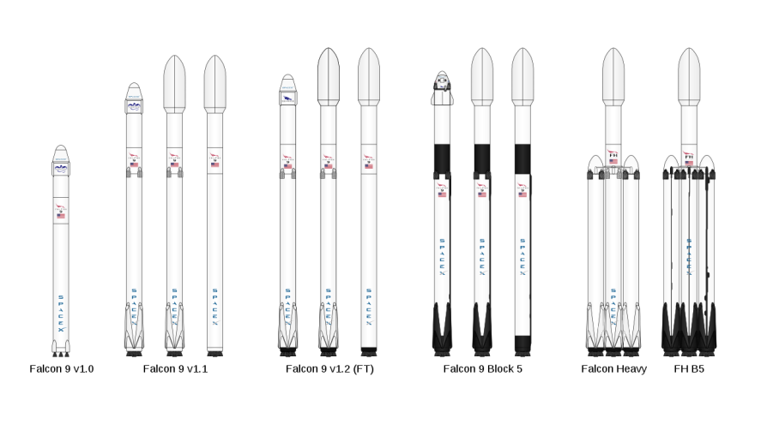
Introduction
SpaceX Falcon 9 is a reusable rocket designed for commercial and government missions. The starting price of each launch is $62 million. By improving the efficiency of the manufacturing processes & research, the cost of launch & materials can be reduced.
For safe and designated landing areas, First Stage Landing Prediction tools are applied.

Slide 5
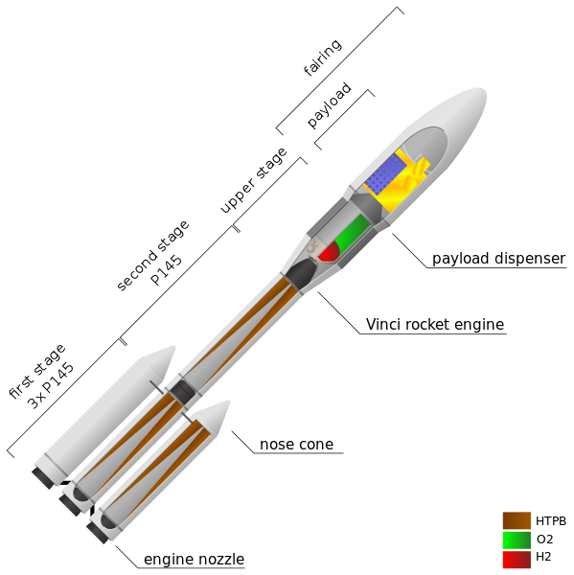
Methodology

Slide 6
Methodology
Data Collection
Data Wrangling
Exploratory Data Analysis (EDA) by using visualization and SQL.
Interactive visual analytics by using Folium and Plotly Dash
Predictive analysis by using classification models.

Slide 7
Data Collection Description
The SpaceX API get request was used for Data collection.
The response was decoded as a Json using .json() function call and turn it into a pandas dataframe using .json_normalize().
The data was cleaned and checked for missing values to fill where necessary.
Web scraping was performed from Wikipedia for Falcon 9 launch records with BeautifulSoup.
The launch records was extracted as HTML table, then the table was parsed and converted to a pandas dataframe.

Slide 8
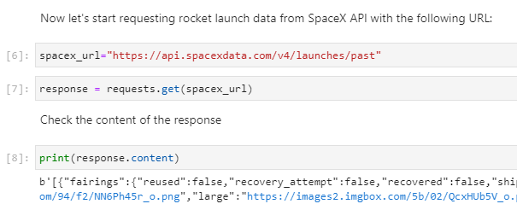
Data Collection – SpaceX API
The SpaceX API was used to collect data, then cleaning, wrangling and formatting were done based on the provided data.
The GitHub URL of the notebook:
Data Collection - GitHub

Slide 9
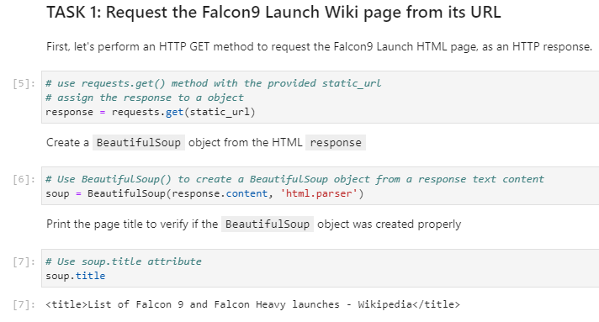
Data Collection – Web Scraping
Web Scraping was performed to collect Falcon 9 Historical launch records with BeatifulSoup.
Data frame was created by parsing the HTML table from the Wikipedia page.
The GitHub URL of the notebook:
Web Scraping - GitHub

Slide 10
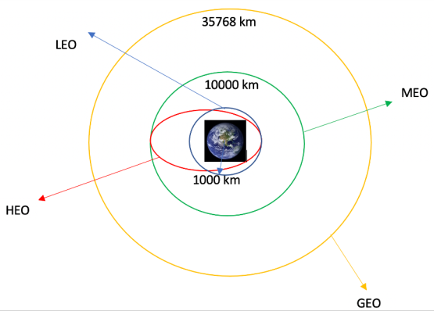
Data Wrangling
Exploratory data analysis (EDA) was performed to determine the training labels through patterns.
The number of launches at each site and the number of occurence of each orbit were calculated
Landing outcome label was created from outcome column and the results were exported to csv.
The GitHub URL of the notebook:
Data Wrangling - GitHub

Slide 11
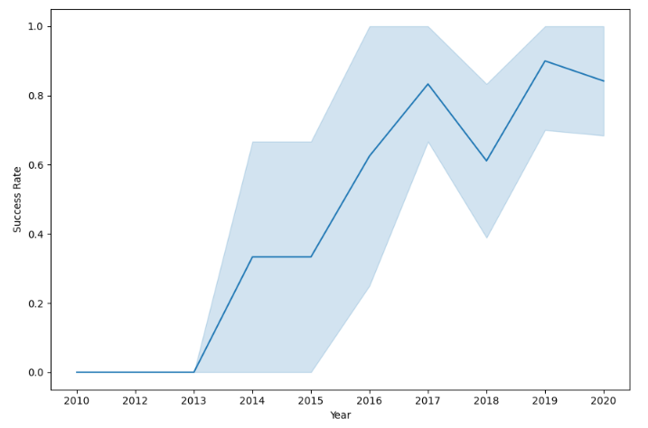
EDA – Data Visualization
By exploring the data, it's possible to visualize the relationship between flight number and launch Site, payload and launch site, success rate of each orbit type, flight number and orbit type, the launch success yearly trend.
The GitHub URL of the notebook:
Data Visualization - GitHub

Slide 12
EDA - SQL
SQL was used to get insights from the data such as:
Display the names of the unique launch sites in the space mission
Display the total payload mass carried by boosters launched by NASA (CRS)
Display average payload mass carried by booster version F9 v1.1
List the total number of successful and failure mission outcomes
List the names of the booster versions which have carried the maximum payload mass
Display the month names, failure landing outcomes in drone ship ,booster versions, launch site for the requested date
Rank the count of successful landing outcomes between certain dates.
The GitHub URL of the notebook:
SQL - GitHub

Slide 13
Interactive Map with Folium
Folium map was created to mark all the launch sites and map objects such as circles, markers and lines to find out the success or failure rate of launches.
Set outcomes for the launch are success=1, failure=0.
The GitHub URL of the notebook:
Interactive Map - GitHub

Slide 14
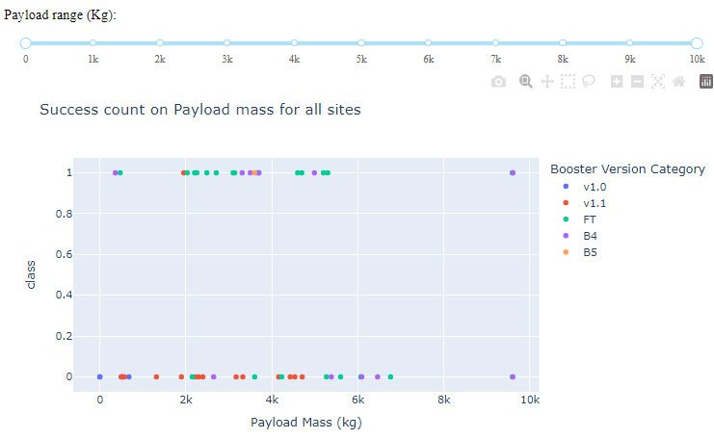
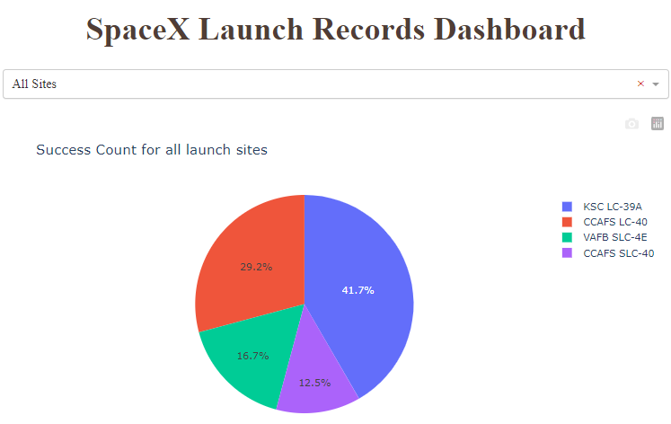
Dashboard with Plolty Dash
an interactive dashboard with Plotly dash was built.
Pie charts that show the total launches by a certain sites were plotted.
Scatter graph that show the relationship with Outcome and Payload Mass (Kg) for the different booster version were plotted.
The GitHub URL of the notebook:
Dashboard - GitHub

Slide 15
Predictive Analysis (Classification)
The data was loaded using numpy and pandas, then transformed and split our data into training and testing.
Different machine learning models were built and expolored different hyperparameters using GridSearchCV.
Accuracy was assigned as the metric for the model, the model was improved using feature engineering and algorithm tuning.
The best performing classification model was found.
The GitHub URL of the notebook:
Predictive Analysis - GitHub

Slide 16
Results

Slide 17
Results
Exploratory data analysis results
Interactive analytics demo in screenshots
Predictive analysis results

Slide 18
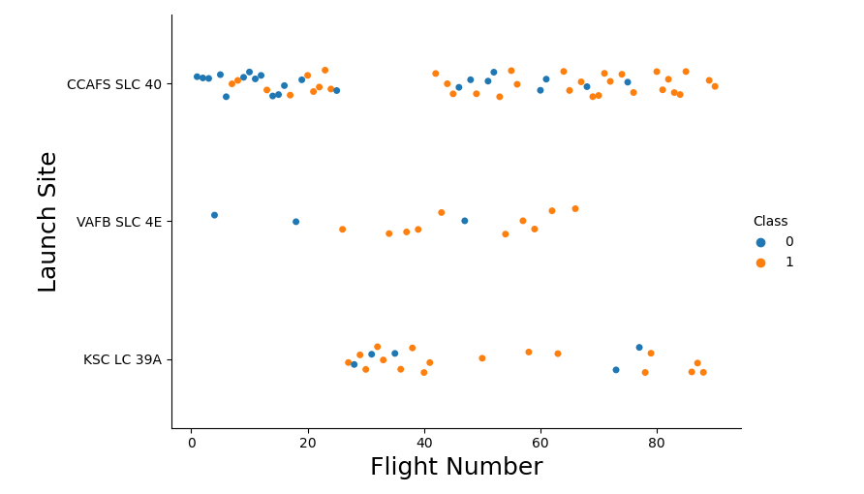
Flight Number vs. Launch Site
From plot, the larger the flight amount at a launch site, the greater the success rate at a launch site.

Slide 19
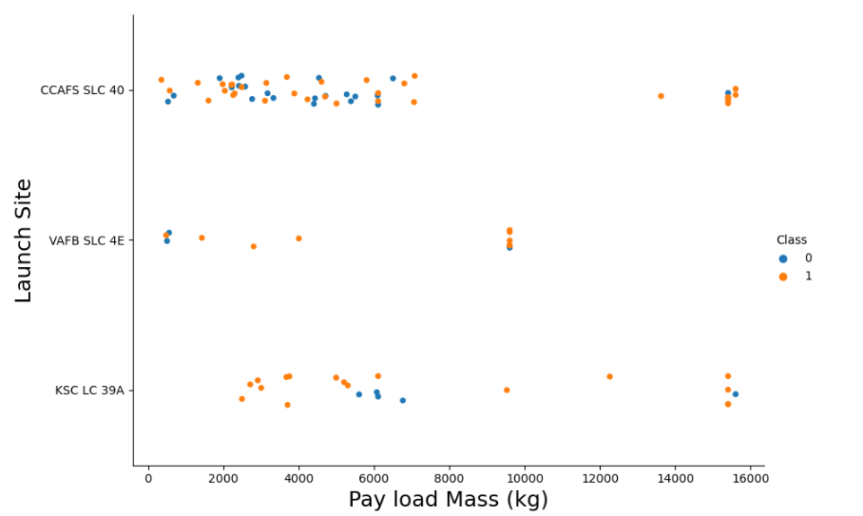
Payload vs. Launch Site
From plot, the greater the payload mass for launch site CCAFS SLC 40, the higher the success rate for the rocket. For VAFB SLC 4E, there are no launches for Pay Load Mass greater than 10,000 kg.

Slide 20
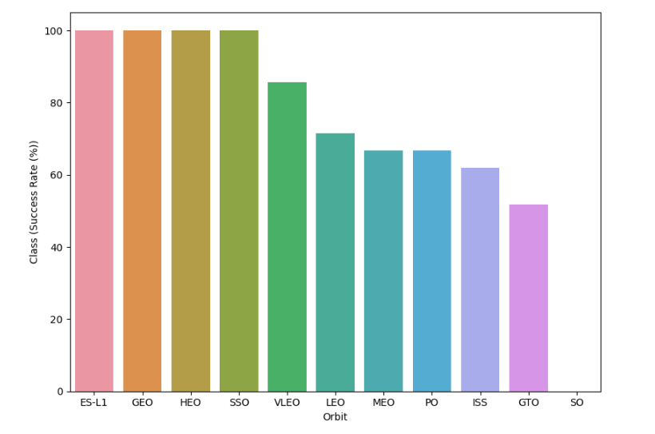
Success Rate vs. Orbit Type
From plot, orbit ES-L1, GEO, HEO & SSO have the highest success rate at 100%, while SO success rate is 0%.

Slide 21
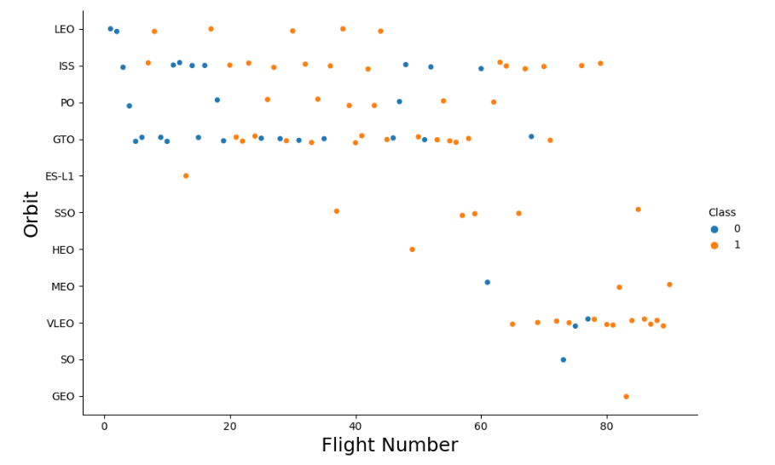
Flight Number vs. Orbit Type
From plot, LEO orbit success rate is related to the number of flights. While for GTO orbit, there is no relationship between flight number and the orbit.

Slide 22
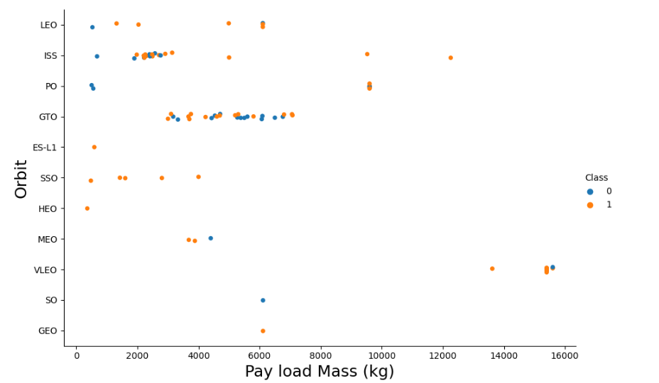
Payload vs. Orbit Type
From plot, LEO, ISS & PO orbits success rate is related to the pay load mass. While for GTO orbit, there is no relationship between the pay load mass and the orbit.

Slide 23
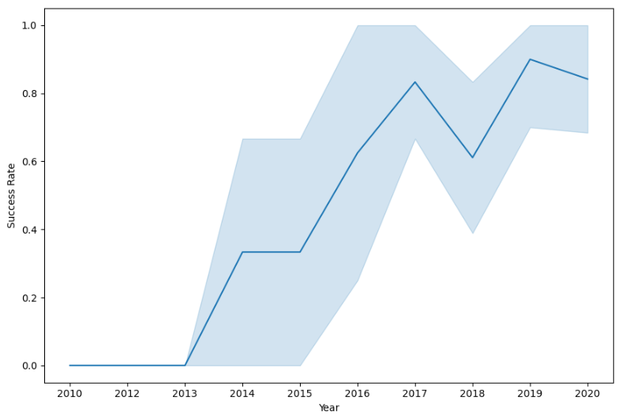
Launch Success Yearly Trend
From plot, the success rate increases from 2013 to 2020, the rate of increase vary from year to year as shown.

Slide 24
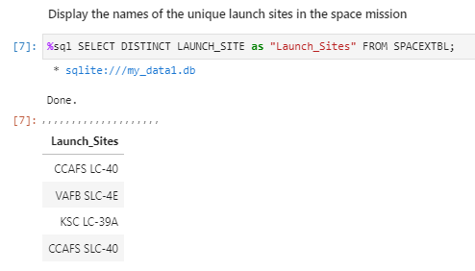
All Launch Site Names
DISTINCT keyword was used to show only unique launch sites from the SpaceX data.

Slide 25
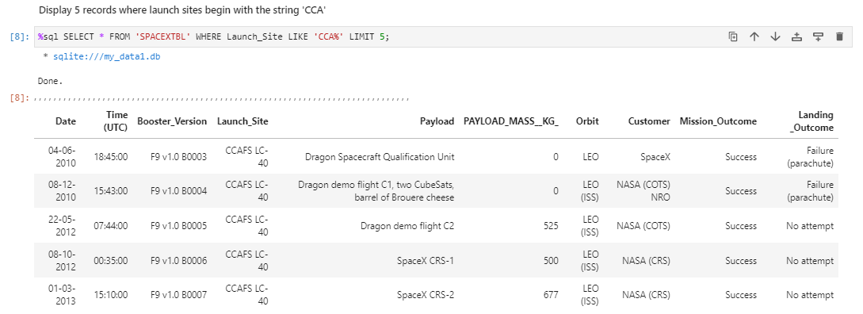
Launch Site Names Begin with 'CCA'
The shown command was used to view 5 records where launch sites begin with ‘CCA’

Slide 26
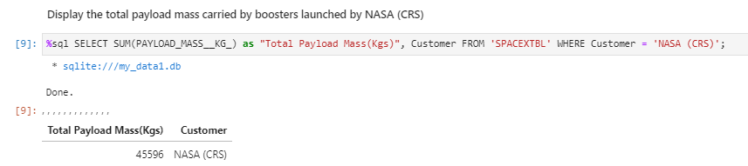
Total Payload Mass
The total payload carried by boosters from NASA is 45596 kg using the shown command.

Slide 27
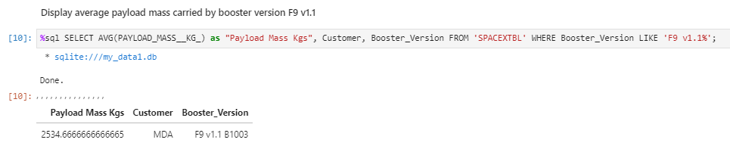
Average Payload Mass by F9 v1.1
The average payload mass carried by booster version F9 v1.1 is 2534.666 using the shown command.

Slide 28
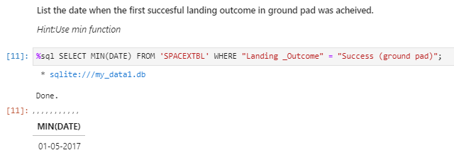
First Successful Ground Landing Date
The first successful ground landing date is 01-05-2017 using the shown command.

Slide 29
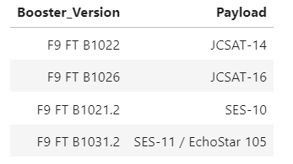
Successful Drone Ship Landing with Payload between 4000 and 6000
The boosters that have successfully Drone Ship Landing were filtered to determine successful landing with payload mass greater than 4000 but less than 6000

Slide 30
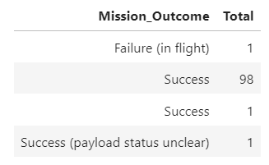
Total Number of Successful and Failure Mission Outcomes
The number of successful and failure missions outcomes are represented using the shown code.

Slide 31
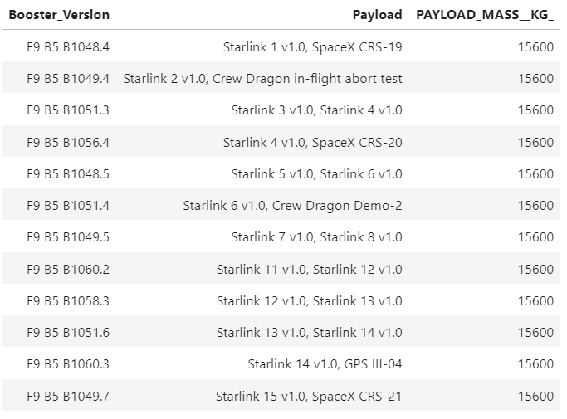
Boosters Carried Maximum Payload
List of boosters that have carried maximum payload mass is shown which is 15600 kg.

Slide 32
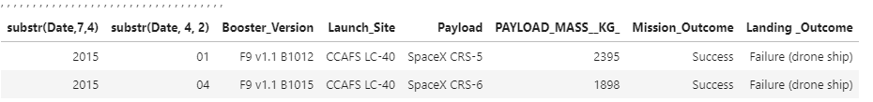
2015 Launch Records
Failed landing outcomes in drone ship, their booster versions, and launch site names for year 2015 were measured by using the shown code.

Slide 33
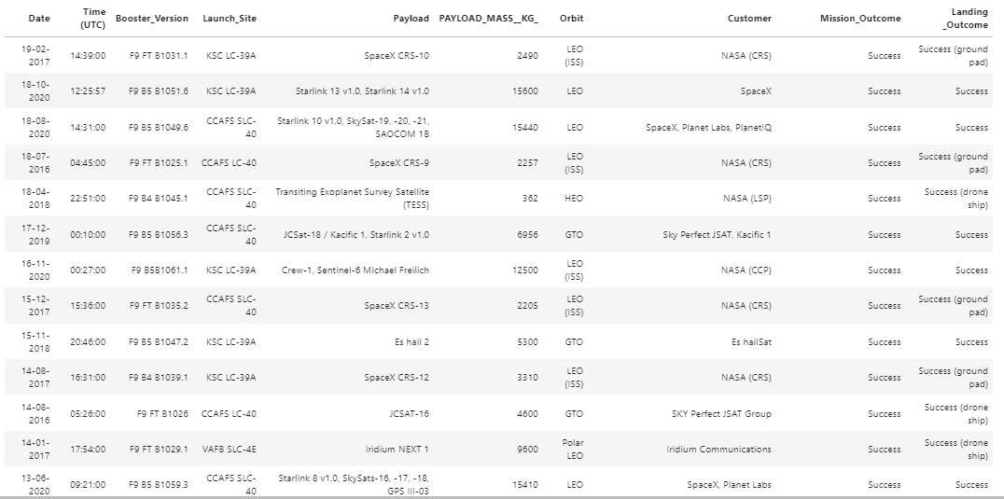
Rank Landing Outcomes Between 2010-06-04 and 2017-03-20
The count of landing outcomes was ranked between 2010-06-04 and 2017-03-20.

Slide 34
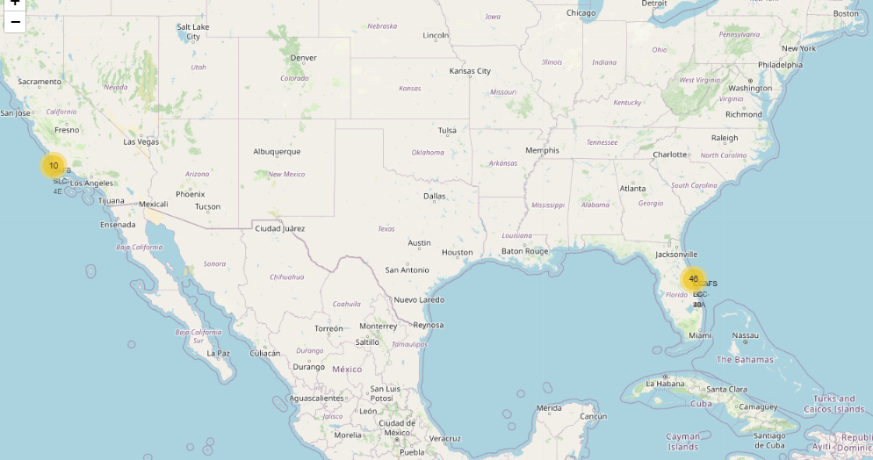
Markers of all launch sites on US
It’s noticed all launch sites are close to the US coast in Florida & California.

Slide 35
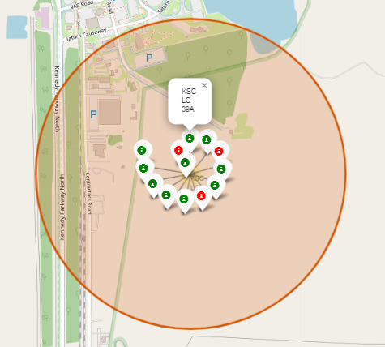
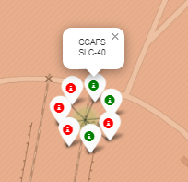
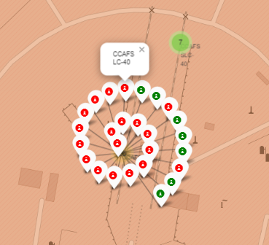
Launch outcomes on map with Color Markers
Florida Sites: Launch Site KSC LC-39A has higher success rate compared to the other two sites.

Slide 36
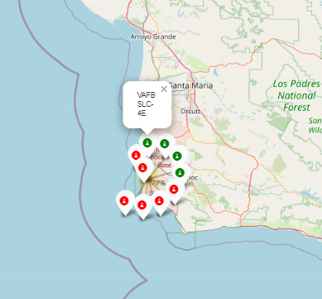
Launch outcomes on map with Color Markers
California Sites: Launch Site VAFB SLC-4E has lower success rate compared to KSC LC-39A launch site in Florida

Slide 37
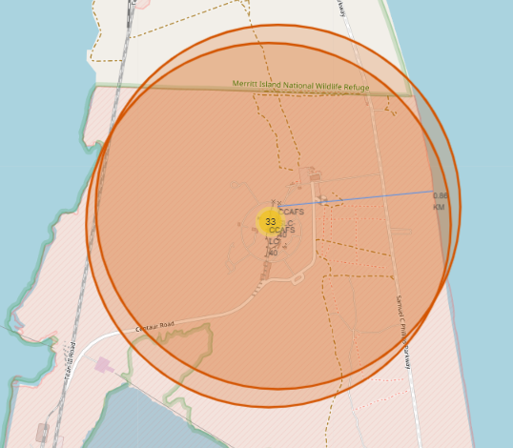
Distance between a launch site to its proximities
California Sites: Launch Site CCAFS SLC-40 proximity to coastline is 0.86 km.

Slide 38
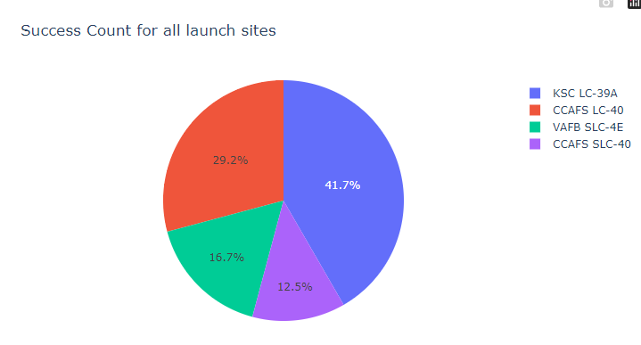
Pie Chart
Pie Chart for launch success count for all sites

Slide 39
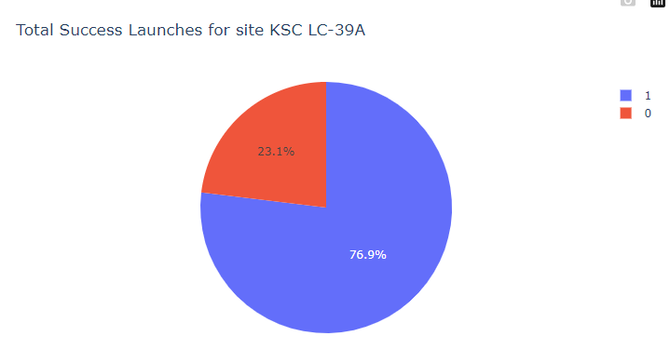
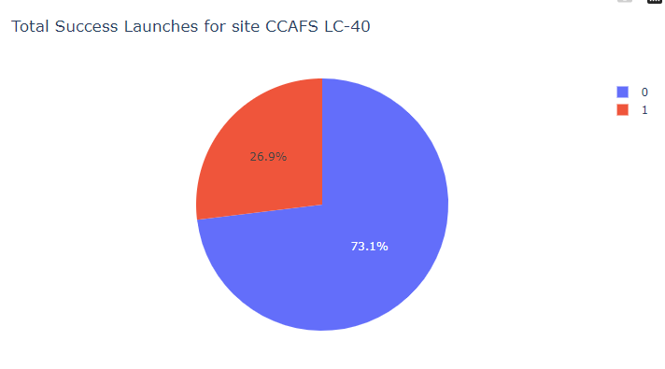
Pie Chart
KSC LC-39A
1st Highest Success Launches
Success rate is 76.9% & Failure rate is 23.1%
CCAFS LC-40
2nd Highest Success Launches
Success rate is 73.1% & Failure rate is 26.9%

Slide 40
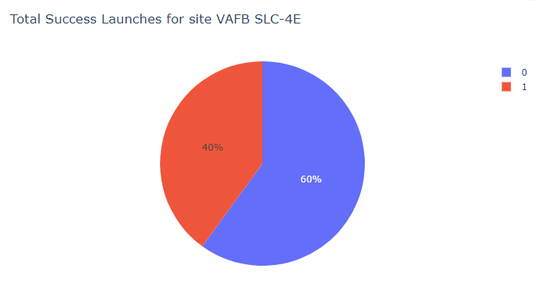
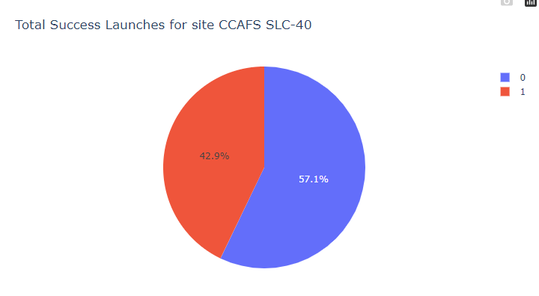
Pie Chart
VAFB SLC-4E
3rd Highest Success Launches
Success rate is 60% & Failure rate is 40%
CCAFS SLC-40
4th Highest Success Launches
Success rate is 57.1% & Failure rate is 42.9%

Slide 41
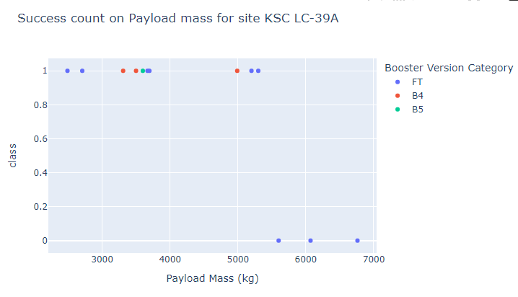
Payload vs. Launch Outcome scatter plot for all sites
The success rate increases when the payload mass decreases.

Slide 42
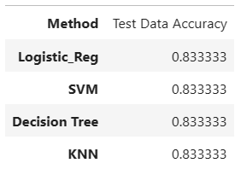
Classification Models Accuracy
All 4 methods have the same accuracy of 0.8333

Slide 43
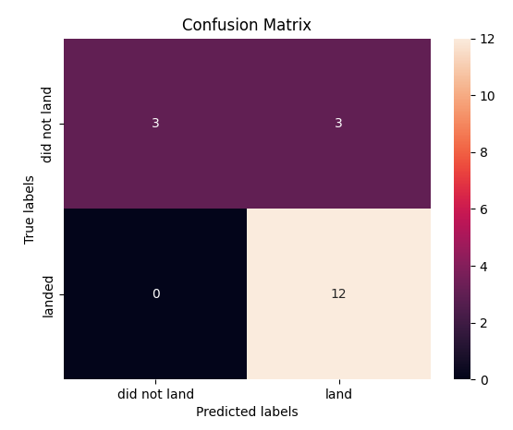
Confusion Matrix
All 4 classification models have the same confusion matrixes and can distinguish between the different classes.
One of the major problems is the false positives such as unsuccessful landing marked as successful landing by the classifier.

Slide 44
Conclusion

Slide 45
Conclusion
Various launch sites have different success rates. For example, KSC LC-39A has the highest success launch rate with 76.9% while CCAFS SLC-40 success launch rate is 57.1%
Launch success rate started to increase from 2013 to 2020.
Orbits ES-L1, GEO, HEO, SSO, VLEO had the most success rate.
The Decision tree classifier is the best machine learning algorithm for this task.

Slide 46
Appendix – GitHub Links
Capstone Project - GitHub
Main GitHub:
Data Collection:
Web Scraping:
Data Wrangling:
Data Visualization:
SQL:
Interactive Map with Folium:
Dashboard with Plolty Dash:
Predictive Analysis (Classification):
Data Collection - GitHub
Web Scraping - GitHub
Data Wrangling - GitHub
Data Visualization - GitHub
SQL - GitHub
Interactive Map - GitHub
Dashboard - GitHub
Predictive Analysis - GitHub

Slide 47
Thanks

